Slide 1
Motivation for selection project topic

Slide 2
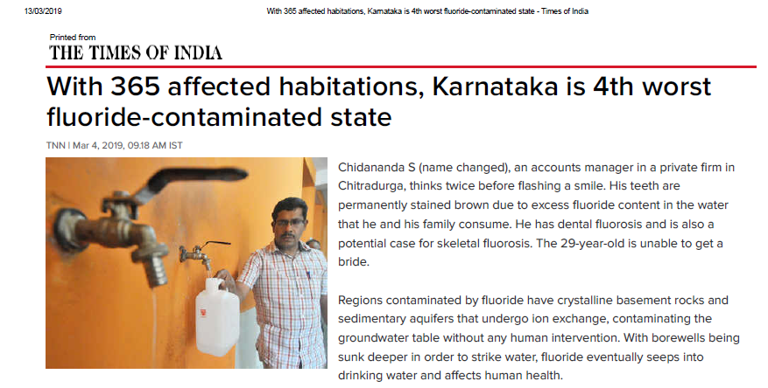
REF:
TIMES OF INDIA 4 MARCH 2019

Slide 3
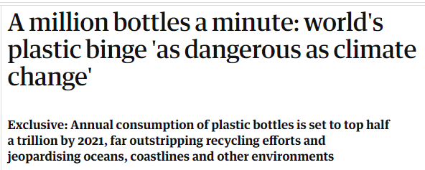
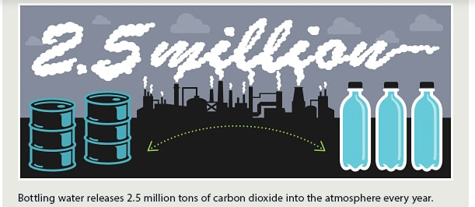
REF:
https://www.printwand.com/blog/plastic-water-bottle-pollution-effects-facts

Slide 4
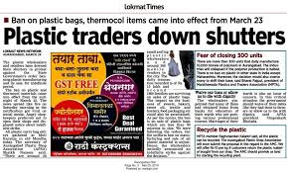

REF:
LOKMAT NEWS PAPER AND TIMES NOW

Slide 5
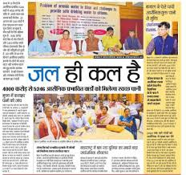

Posted August 29th, 2018 Sulabh News .

Slide 6
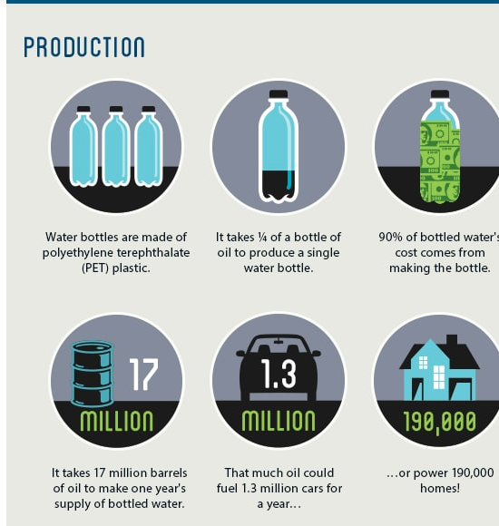
REF:
https://pacinst.org/publication/bottled-water-and-energy-a-fact-sheet/

Slide 7

https://www.printwand.com/blog/plastic-water-bottle-pollution-effects-facts

Slide 8
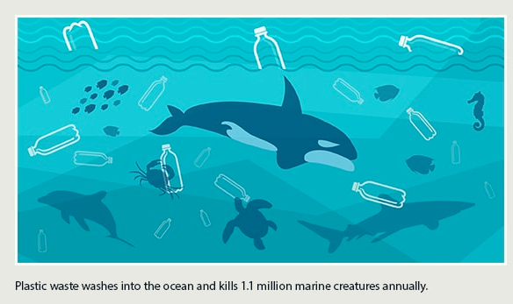
REF:
https://greenerideal.com/infographics/the-environmental-impact-of-plastic-water-bottles/

Slide 9
3 STEP SOLUTION
SOLUTION
Drinkable Water Distribution via Automatic Dispensing Machine
Promote Paper glass use rather than plastic glass in accordance with plastic ban
Shift from Human Water Distribution to iOT based water distribution network

Slide 10
Drinkable Water Distribution via Automatic Dispensing Machine
Tooru Kajimura, Nobuhiko Kametani and Toshihisa Miyagishi, “Present Status and Future Prospects of Vending Machines”, FUJI ELECTRIC REVIEW, Volume 49, Issue 1.

Slide 11
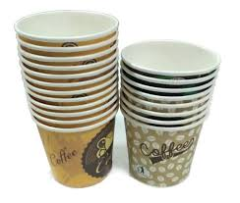


Promote Paper glass use rather than plastic glass in accordance with plastic ban
Inspiration-

Slide 12
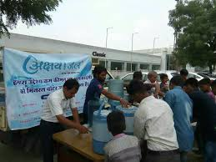
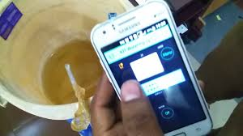
Shift from Human Water Distribution to iOT based water distribution network

Slide 13
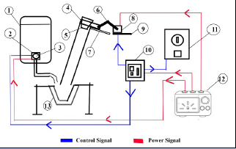
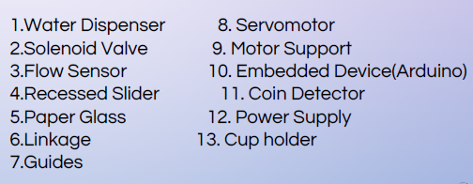
3D model Line Diagram

Slide 14
Video

Slide 15
Work distribution
SMART WATERS
Project Guide Monitoring
iOT and embedded circuits
Electrical and Heating Section
Hydraulic circuits
Mechanisms
Manufacturing

Slide 16
Controlling System

Slide 17
Flow chart
Flow chart

Slide 18
Electronic Components
Hardware:
Arduino Mega
Servo motors (10kgcm)
Relay for operating heater
WIFI Module for communication.

Slide 19
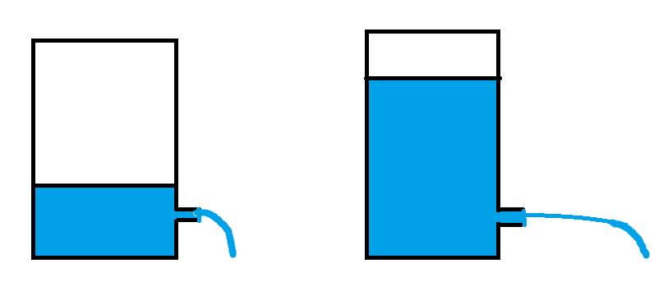
Need for water level measurement
The water level present In the smaller and larger container should be known so that flow rate of the water can be determined.
This change in the flow rate will change the time required to fill the glass.

Slide 20
Methods for measuring water level:
Counting amount of water dispensed.
Weight measurement.
Level Measurement.

Slide 21
Counting amount of water dispensed.
This is based on the assumption that initial volume of the water in both the containers is known.
By knowing the water dispensed , The actual volume and head available can be found and hence the flow rate can be estimated.
This method is completely theoretical, doesn’t need any instrumentation but depends mainly upon initial volume calculation accuracy.

Slide 22
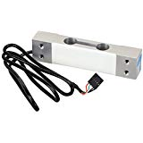
Weight measurement.
This method includes measuring the weight of water present in the container by using load sensor and then from weight measuring the head, flow rate and then estimating time for filling the glass.
This method requires an load cell for weight measurement but it is more accurate with easy to interpret results.

Slide 23
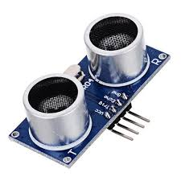
Water level measurement
Water level or head of water available can be easily found using an ultrasonic sensor.
The ultrasonic sensor can be placed above the larger plastic container so that thickness of container comes in blind range of the sensor and it can give water level present in the container.
But these results are subjected to error due to presence of the plastic wall in blind range of sensor.

Slide 24
Internet of things :
The IOT is used for making the water dispenser smart.
This is done by establishing the communication between water dispenser and another device connected to internet like a smartphone.
By establishing the communication, these two devices can exchange information like water level, No of normal and hot water glasses dispensed in a day.

Slide 25
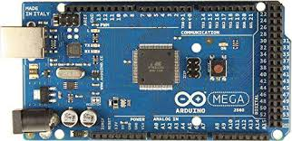
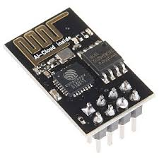

IOT Block Diagram
Internet
Dispenser Controller
WiFi
ESP
8266
Smart
Phone telegram app

Slide 26
ELECRICAL AND HEATING SECTION

Slide 27
ELECRTICAL CIRCUIT OF THE ENTIRE PROJECT
Elements-
SMPS (Switch Mode Power Supply)
4 servo motors
1 coin detector
1 embedded device (Arduino)
Relay
Induction heater

Slide 28
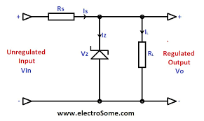
POWER SUPPLY SELECION
Zener Voltage regulator

Slide 29
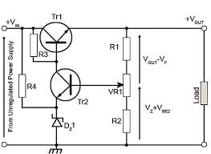
Transistorised series regulator

Slide 30
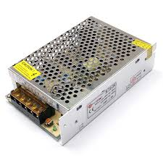
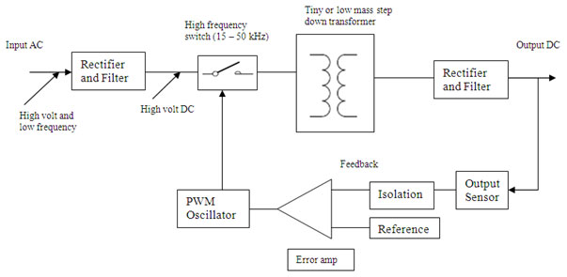
SMPS (Switch mode power supply)

Slide 31
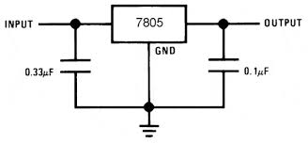
For servos and control circuit

Slide 32
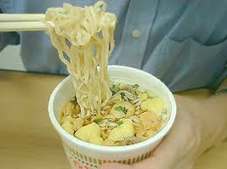
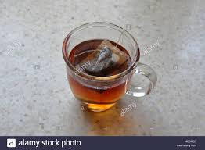
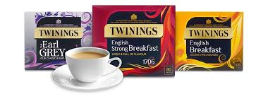
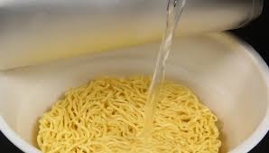

HEATING SECTION
Need for heating in water dispenser

Slide 33
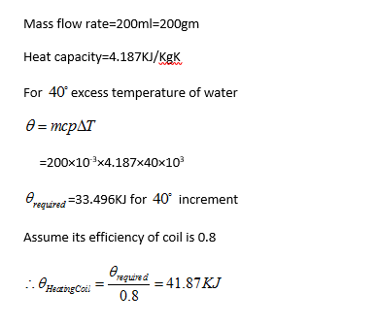
Calculations and outcomes
Thus for a single paper glass of water to be heated, up to 40 degrees rise, we require 41.87 KJ of energy to be provided.

Slide 34
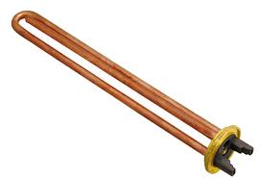
RESISTANCE HEATING
Merits-
Easy circuit, least losses as heat completely utilized as heater
Is completely immersed in water
COST-
Rs 750 for
150 Watt
Demerits-
It will be immersed in water for prolonged time, may cause ion dissociation and impurities collection
Live current directly in water, so short-circuit.
Time
5 minutes

Slide 35
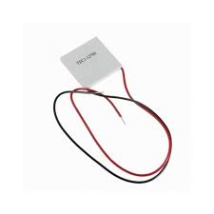
PELTIER HEATING
Merits-
Based on thermo-electric heating
Compact in size to use in any design
COST-
Rs 240 for
60 Watt
Demerits-
Thermo-electric cooling has just a thermal efficiency of 15 %.
To reduce time for heating, to increase wattage, cost for heating will increase.
Time
11 minutes

Slide 36
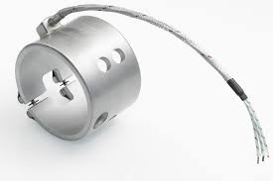
BAND HEATING
Merits-
Not immersed in water, so safe from electric shocks.
Purity of water is entrusted.
More suited in geometry as can be easily mounted over
discharge tubes.
COST-
Rs 1000 for
150 Watt
Demerits-
Initial cost is too high for a single watt.
To reduce time for heating a series of band heaters
will be required which will increase cost of project
dearly
Time
5 minutes

Slide 37
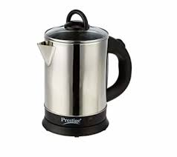
INDUCTION HEATING
Merits-
Indirect heating, coils not in direct contact with drinking water
so no risk of shocks and purity of water assured.
2. Initial cost per wattage is much less.
COST-
Rs 600 for
970 Watt
Demerits-
Direct selection of induction appliance from market.
More rigidity in geometric aspects for drilling of holes from
cylindrical surfaces.
Time
44 seconds

Slide 38
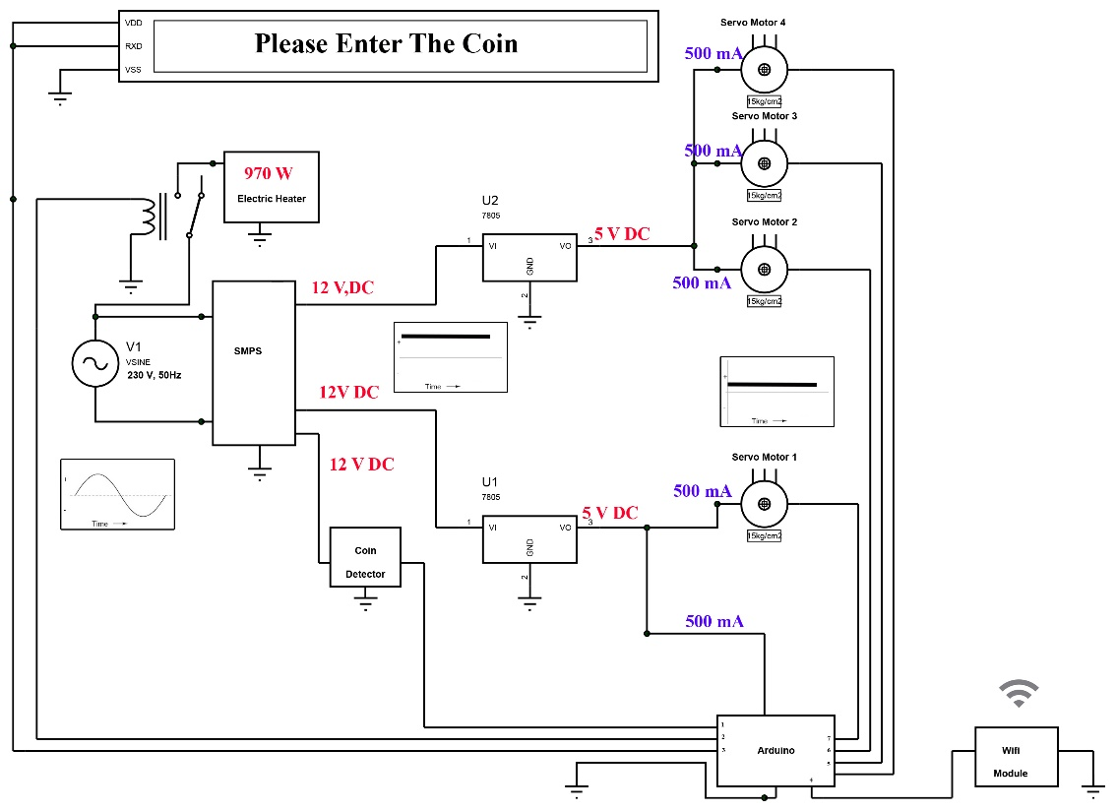
Complete circuit
Control Pins
Of Arduino
Coin Detector 1
Relay 2
LCD Display 3
WiFi Module 4
Servo 5,6,7
Created on
Proteus 7.0 Software

Slide 39
Manufacturing

Slide 40
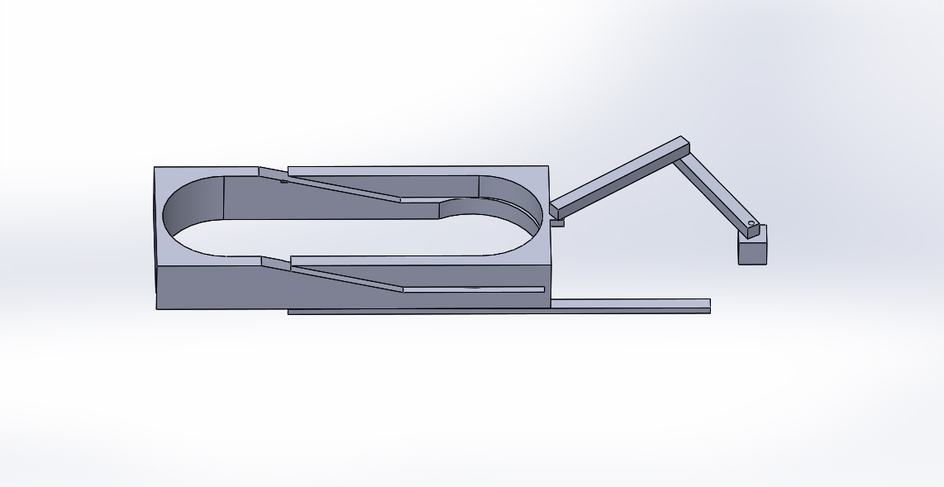
3D Printing

Slide 41
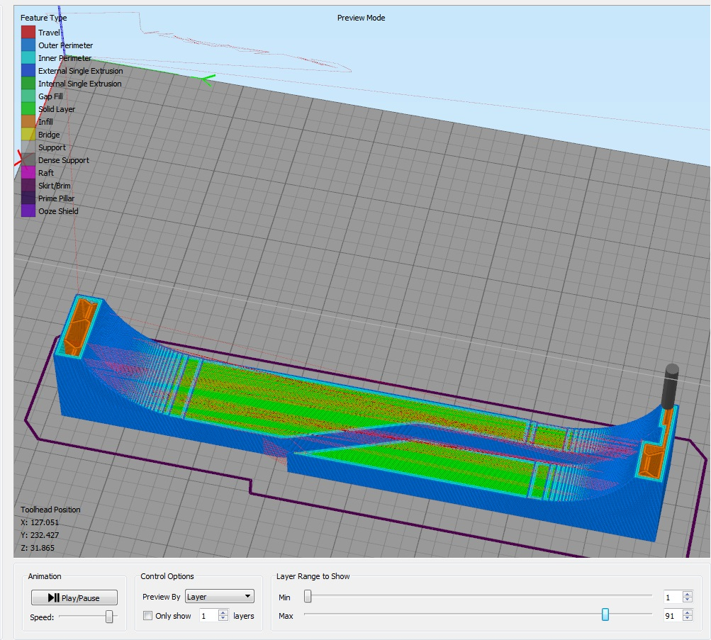
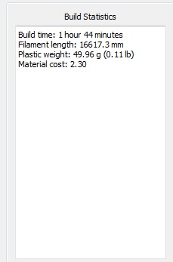
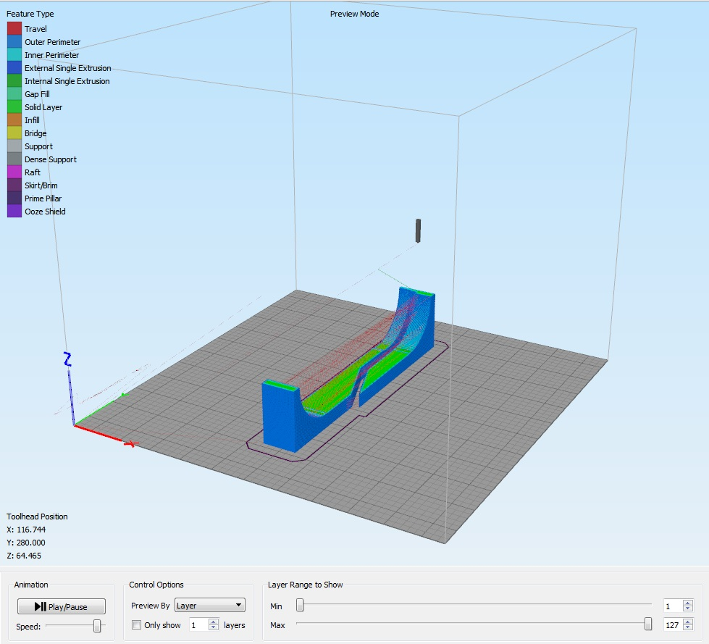
3D Printing

Slide 42
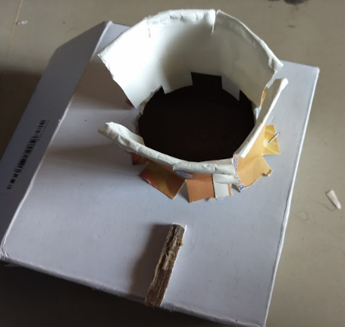
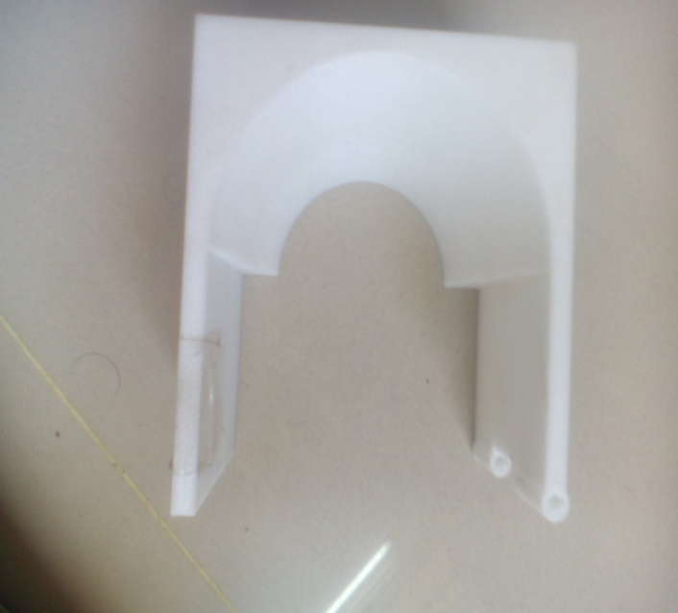
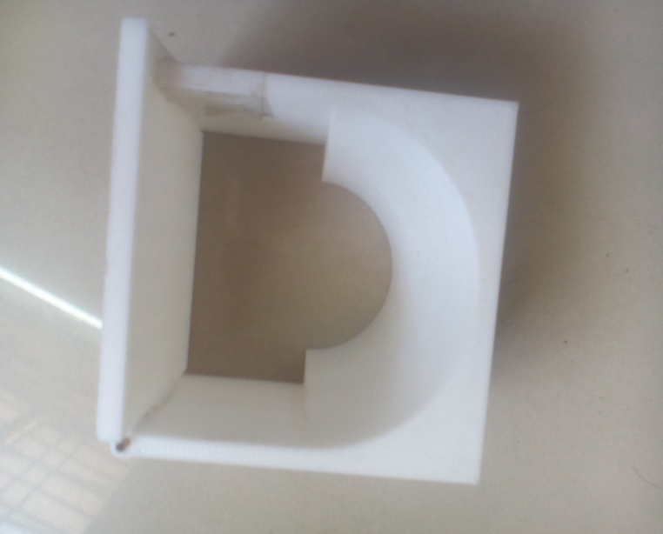
Cup Holder
Transformation

Slide 43
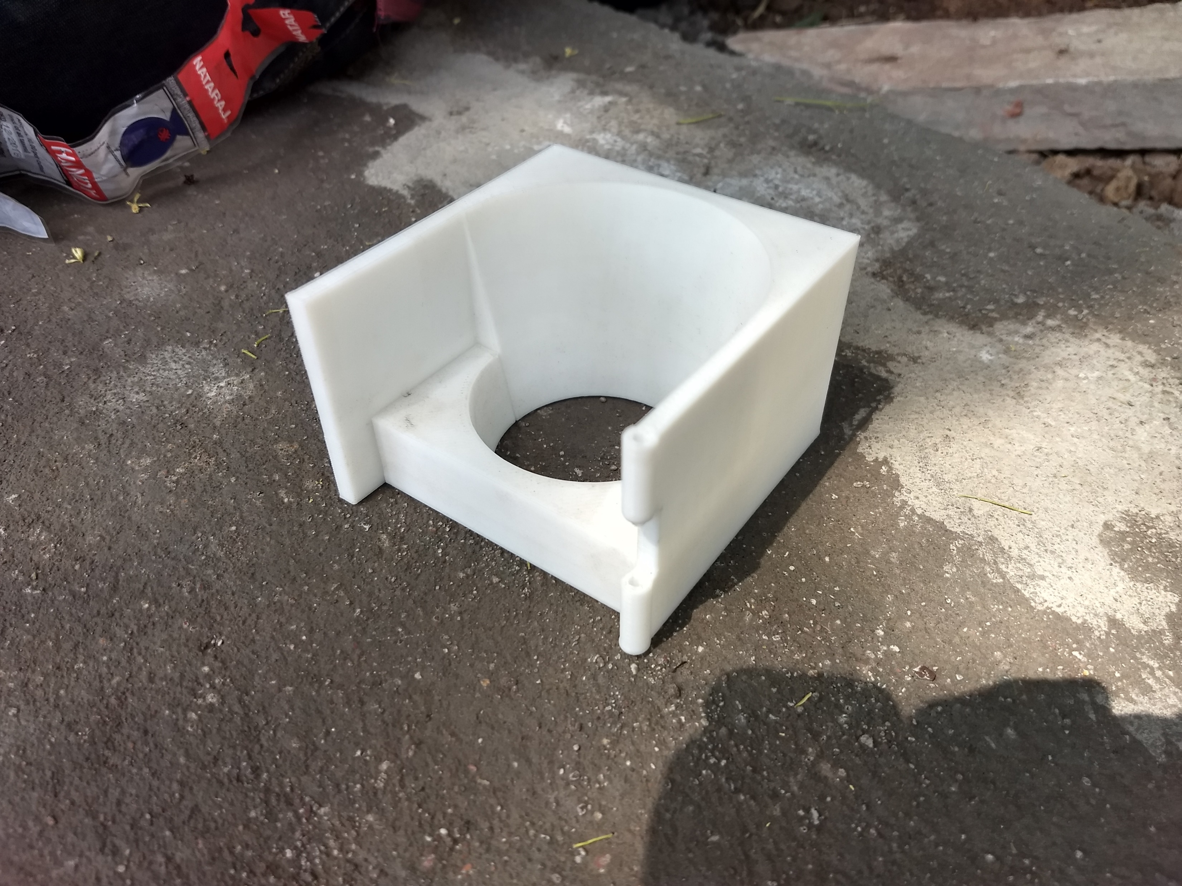
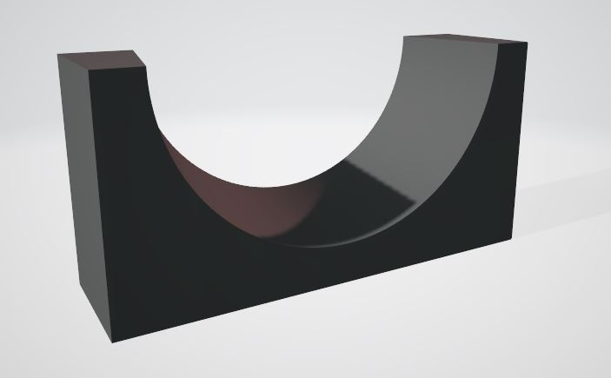
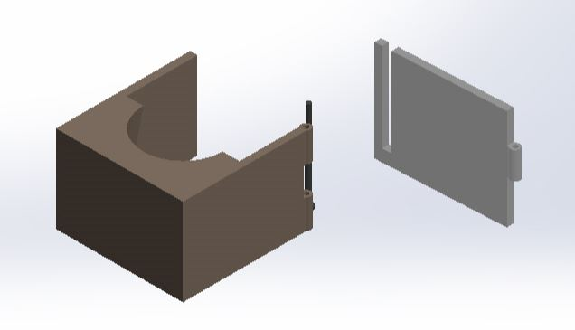
3D Printing

Slide 44
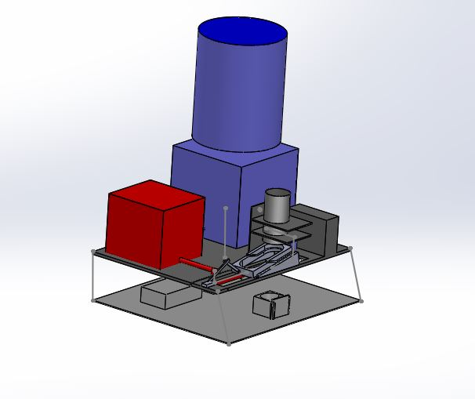
3D Model

Slide 45
Specification
Total volume= 55cm *60cm *80cm (with replacable container)
Total volume= 55cm *60cm *44cm (without container)
Channel Used-
1)L section (2.5cm *.25cm)
2)Simple Strip (2.5cm * .2cm)
Total weight of supporting truss(assuming density=7850kg/m^3)
= 7.2kg

Slide 46
Cost and Gantt Chart
Proposed Work
Assembly of all parts
Validation of assembly to the most accurate level
Shielding/ Covering Electronic and Electrical equipments waterproof
Aesthetic look by wrapping sheet metal around it

Slide 47
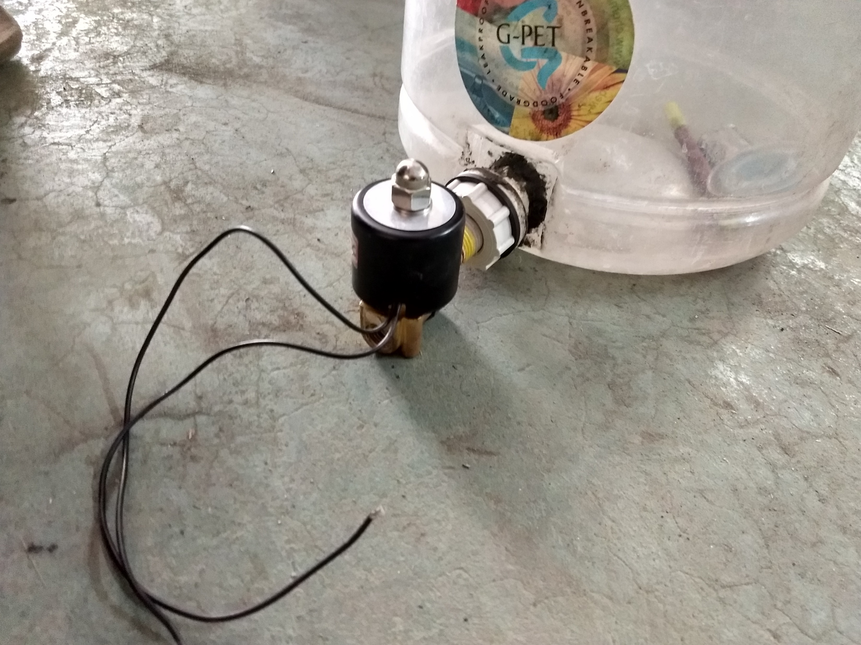
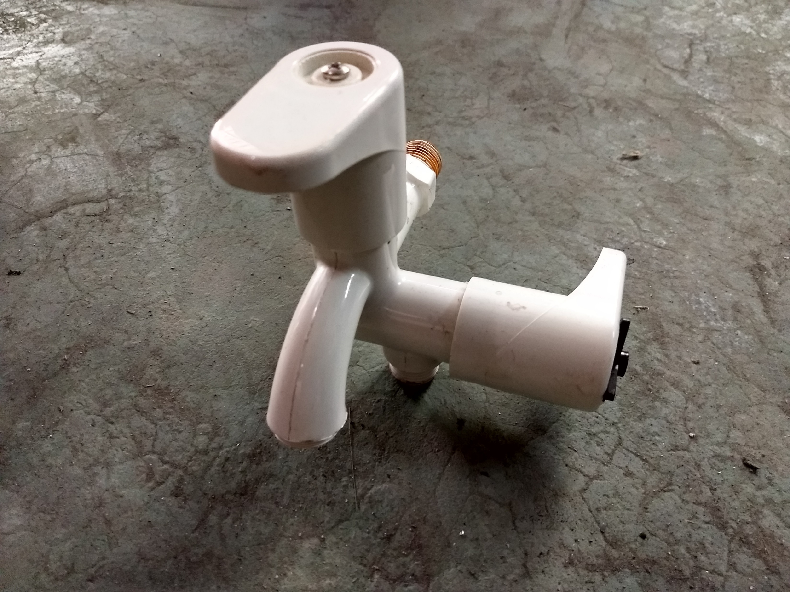
Design Changes for maximum flow rate
Saved
Rs 600
3 Solenoid Valves
= Rs.2100
1Combined Tap +1 Single Tap+ 3Servo
=Rs.1500

